Slide 1
Antimicrobial chemotherapy
Dr. Haider Abdul-Lateef Mousa

Slide 2
Learning Objectives
•To understand how antibiotics work
• To review how drug resistance develops in bacteria
• T o summarize current status of antimicrobial resistance in selected bacteria
• To understand how resistant organisms are detected in the clinical laboratory

Slide 3
Antimicrobial chemotherapy is the clinical application of antimicrobial agents to treat infectious disease.
There are five types of antimicrobial chemotherapy:
1. Antibacterial chemotherapy, the use of antibacterial drugs to treat bacterial infections
2. Antifungal chemotherapy, the use of antifungal drugs to treat fungal infections
3. Anthelminthic chemotherapy, the use of antihelminthic drugs to treat worm infections
4. Antiprotozoal chemotherapy, the use of antiprotozoal drugs to treat protozoan infections
5. Antiviral chemotherapy, the use of antiviral drugs to treat viral infections

Slide 4
Terminology
• Antimicrobial drugs - Interfere with the growth of microbes within a host.
• Antibiotic - Of biological origin. Produced by a microbe, inhibits other microbes (penicillin). Can be modified to enhance efficacy (semisynthetic).
• Chemotherapeutic agent - Synthetic chemicals (Sulfa drugs).
• Antiseptic – An agent used to inhibit or eliminate microbes on skin or other living tissue (alcohol, iodine, chlorhexidine)
• Disinfectant – An agent used to destroy microbes on inanimate objects (phenols, formaldehyde, chlorine)

Slide 5
The susceptibility of microbes to different antibiotics varies greatly
Gram-positive and gram-negative bacteria vary in their sensitivity to antibiotics
Broad-spectrum antibiotics are effective against both groups of bacteria

Slide 6
Features of Antimicrobial Drugs
Selective toxicity: Drug kills pathogens without damaging the host.
Therapeutic index: ratio between toxic dose and therapeutic dose – High therapeutic index ⇒ less toxic
Antimicrobial action – Bacteriostatic vs. bactericidal
Activity Spectrum – Broad-spectrum vs. narrow- spectrum
Tissue distribution, metabolism, and excretion – Unstable in acid; half-life duration

Slide 7
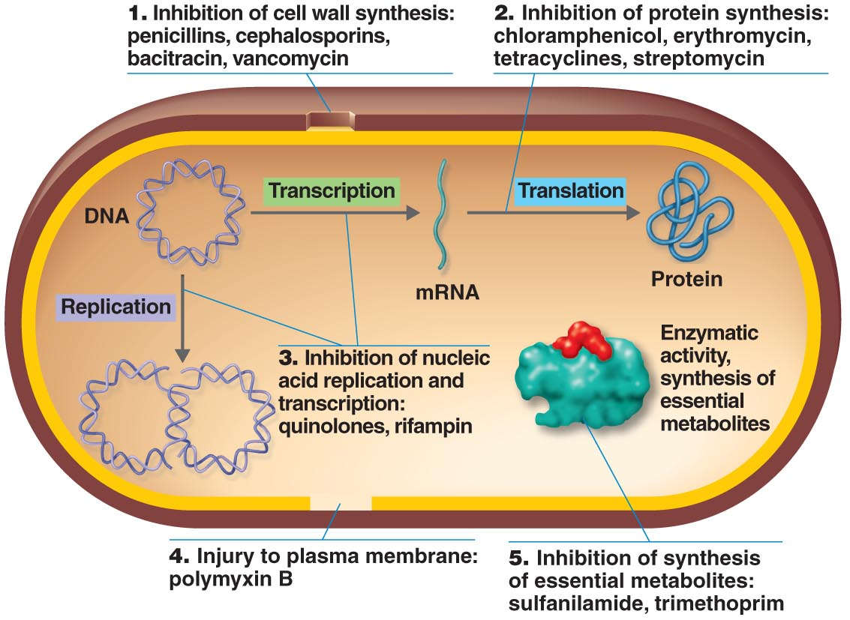
The Action of Antimicrobial Drugs

Slide 8
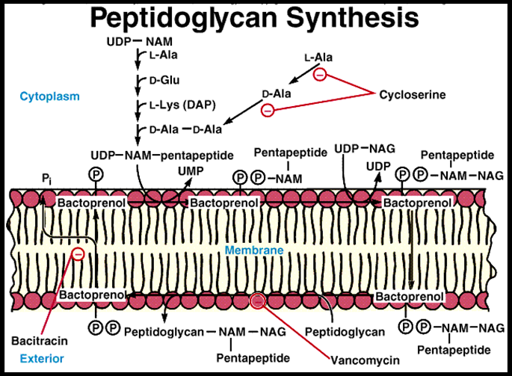
Classification of Antibiotics by Mechanism of Action
Inhibition of cell wall synthesis
Beta-lactam drugs
Penicillins
Cephalosporins
Carbapenems
The others
Cycloserine
Vancomycin
bacitracin

Slide 9
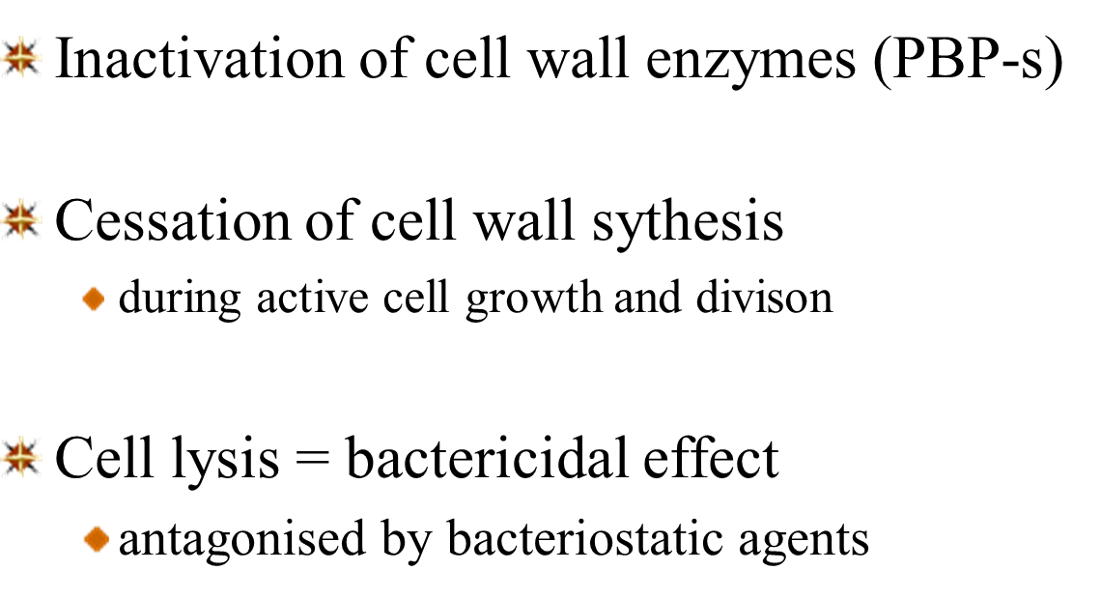
Antibacterial mechanism of β-lactams

Slide 10
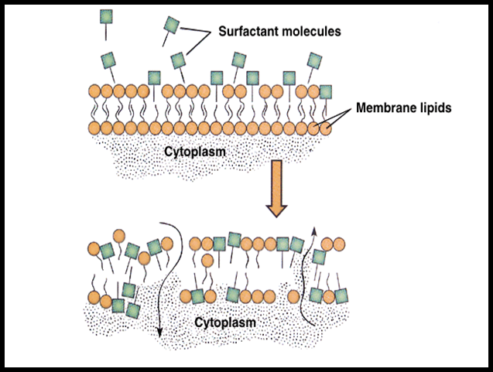
Disruption of cell membranes
Polymyxin
Polyenes (anti-fungal agents)

Slide 11
Inhibition of protein synthesis
Reversible inhibition (bacteriostatic)
Chloramphenicol
The tetracyclines
The macrolides (erythromycin)
Clindamycin
Streptogramins
Linezolid
Irreversible – the bactericidal aminoglycosides

Slide 12
β-Lactam Antibiotics: Penicillins and Cephalosporins
β-Lactam antibiotics are one of the most important groups of antibiotics of all time
Include penicillins, cephalosporins, and cephamycins
Over half of all antibiotics used worldwide
Penicillins
Discovered by Alexander Fleming in1928.
Primarily effective against gram-positive bacteria
Some synthetic forms are effective against some gram-negative bacteria
Target cell wall synthesis
Cephalosporins
Produced by fungus Cephalosporium
Same mode of action as the penicillins

Slide 13
Antibacterial Antibiotics Inhibitors of Cell Wall Synthesis: Penicillin
Natural and semisynthetic penicilins contain β-lactam ring
Natural penicillins produced by Penicillium are effective against Gram + cocci and spirochetes
Semisynthetic penicillins: made in laboratory by adding different side chains onto β-lactam ring ⇒ penicillinase resistant and broader spectrum of activity

Slide 14
Penicillinase (β-lactamase): bacterial enzyme that destroys natural penicillins Penicillinase resistant penicillins: methicilin replaced by oxacilin and nafcilin due to MRSA Extended-spectrum penicilins: Ampicilin, amoxicilin; new: carboxypenicilins and ureidopenicillins (also good against P. aeruginosa)

Slide 15
Cephalosporins
Produced by Fungi of genus Cephalosporium ⇒ 4 Generations of cephalosporins.
First-generation: Narrow spectrum, gram-positive
Second-generation: Extended spectrum includes gram-negative
Third-generation: Includes pseudomonads; mostly injected, some oral.
Fourth-generation: Most extended spectrum

Slide 16
Cephalosporins cont.
Structure and mode of action resembles penicilins
More stable to bacterial β-lactamases than penicilins
Broader spectrum ⇒ used against penicillin-resistant strains

Slide 17
Vancomycin
Glycopeptide from Streptomyces
Inhibition of cell wall synthesis
Used to kill MRSA (Methicillin-resistant Staphylococcus aureus)

Slide 18
Antibiotics from Prokaryotes
Many antibiotics effective against Bacteria are also produced by Bacteria
Aminoglycosides are antibiotics that contain amino sugars bonded by glycosidic linkage
Examples: Gentamicin, kanamycin, neomycin, amikacin
Not commonly used today
Neurotoxicity and nephrotoxicity
Considered reserve antibiotics for when other antibiotics fail

Slide 19
Antibiotics from Prokaryotes, cont.
Macrolides contain lactone rings bonded to sugars
Example: erythromycin
Broad-spectrum antibiotic that targets the 50S subunit of ribosome
Tetracyclines contain four rings
Widespread medical use in humans and animals
Broad-spectrum inhibition of protein synthesis
Inhibits functioning of 30S ribsomal subunit

Slide 20
Antifungal Drugs
Polyenes, such as nystatin and amphotericin B, for systemic fungal infections. Inhibition of ergosterol synthesis ⇒ fungicidal. Nephrotoxic
Griseofulvin from Penicillium. Systemic/oral. Binds to tubulin ⇒ For Tineae

Slide 21
Antiviral Drugs
Nucleoside analogs inhibit DNA synthesis
Acyclovir and newer derivatives: Selective inhibition of herpes virus replication. Acyclovir conversion to nucleotide analog only in virus infected cells ⇒ very little harm to uninfected cells!
Oseltamivir (Tamiflu) is an antiviral medication used to treat and prevent influenza A and influenza B. It is a neuraminidase inhibitor, a competitive inhibitor of influenza's neuraminidase enzyme.
Paxlovid (nirmatrelvir tablets and ritonavir tablets), and molnupiravir used for the treatment of mild-to-moderate coronavirus disease (COVID-19).

Slide 22
Antiprotozoan and Antihelminthic Drugs
Examples of Antiprotozoan:
Chloroquine: Malaria
Quinacrine: Giardia
Metronidazole (Flagyl): Entamoeba histolytica, Vaginitis, anaerobic bacteria
Examples of Antihelminthic:
Niclosamide and praziquantel: Tapeworm
Mebendazole: broadspectrum antihelmintic
Ivermectin: nematodes, mites, lice . . .

Slide 23
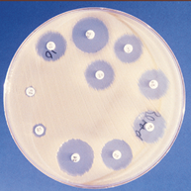
Antibiotic Assays to Guide Chemotherapy
Agar Disk Diffusion Method determines susceptibility of an organism to a series of antibiotics: Kirby-Bauer test
Dilution Susceptibility Tests: Minimal inhibitory conc. ( MIC ) – Lowest conc. of a drug that ↓ bacterial growth .
Measurement of Drug Concentration in the Blood

Slide 24
THANK YOU

